Slide 1

Internship Presentation on
Work with Python with Django
Submitted by: Shweta V. Vyas
Enrollment no. : 180753107007
Department Of Computer Engineering,
SVBIT
Date: 02/03/2022
Guided by: Prof. Tushar Pokar,
Department Of Computer Engineering,
SVBIT

Slide 2
Contents:
Introduction to Praxware Technologies
What I learnt till now?
What I will learn in upcoming days...

Slide 3

Introduction to Praxware Technologies
Praxware Technologies is one of the well known It Developement,Training & Placement Service provider.
It offers variety of services including web and Mobile Developement, Corporate Training and Digital Marketing with quality assurance.

Slide 4
Introduction to Praxware Technologies
Praxware Technologies has its offshore development centre, the custom software development firm in Ahmadabad, which started its operation in February 2015.
The company provides services in the field of custom software development and information technology consulting and training.

Slide 5
Introduction to Praxware Technologies
Mode of Internship: Remote ( Work from home)
Duration of Internship: 4 Months

Slide 6

What I learnt ? 1. Introduction about Python
Python is a widely used general-purpose, high-level programming language.
It was initially designed by Guido van Rossum in 1991 and developed by Python Software Foundation.
It was mainly developed for emphasis on code readability, and its syntax allows programmers to express concepts in fewer lines of code.

Slide 7
2. Features
Easy to code
Free and Open Source
Object Oriented language
Interepreted language
Large standard library

Slide 8
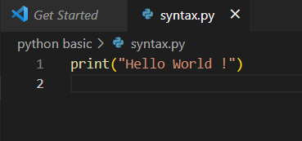
3. Basic syntax

Slide 9
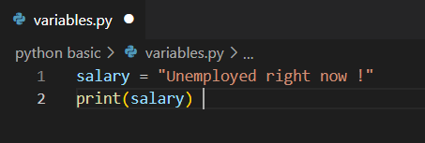
4. Variable and Data types

Slide 10
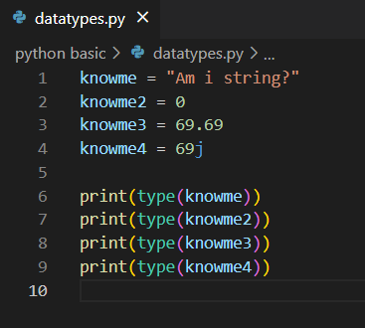
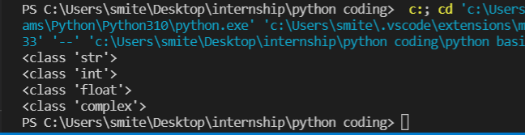
4. Variables and Data types
Some useful datatypes are string, integer, float, complex, list, tuple, set, dictionary, boolean etc.

Slide 11
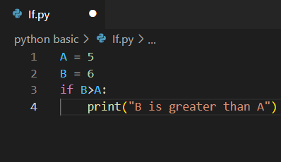

5. Conditional Statements
if (condition):
print(“something”)

Slide 12
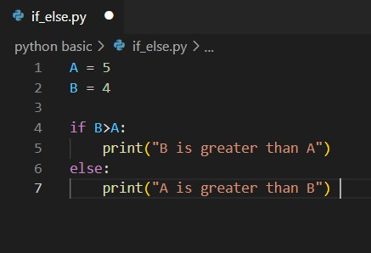

5. Conditional Statements
if(condition):
print(“something”)
else:
print(“something”)

Slide 13
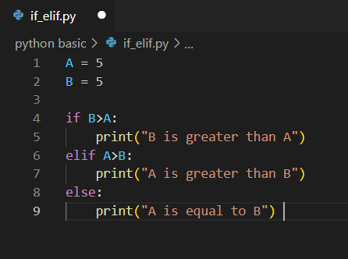

5. Conditional Statements
if(condition):
print(“something”)
elif(condition):
print(“something”)
else:
print(“something”)

Slide 14
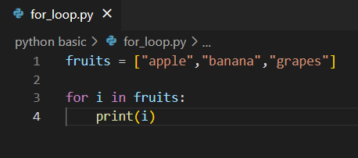
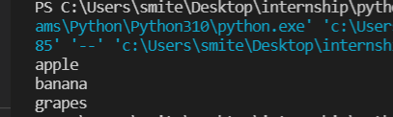
6. Loops
for loop :

Slide 15
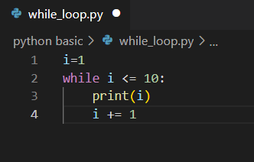
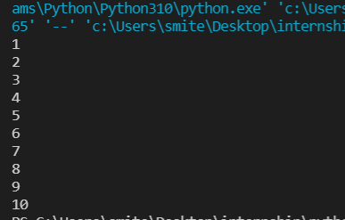
6. Loops
while loop:

Slide 16
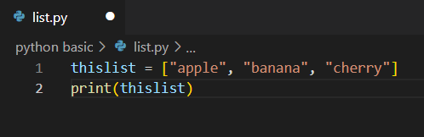

7. List
Lists are used to store multiple items in a single variable.
List items are ordered, changeable, and allow duplicate values.

Slide 17
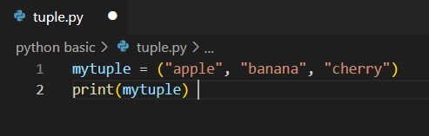

8. Tuple
Tuple items are ordered, unchangeable, and allow duplicate values.

Slide 18
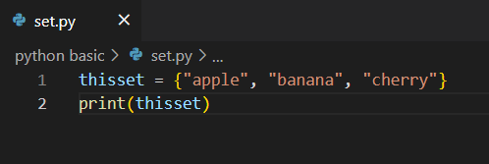
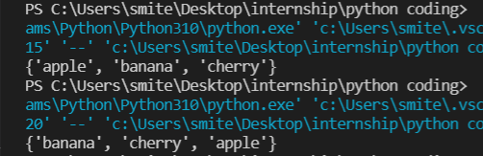
9. Set
Set items are unordered, unchangeable, and do not allow duplicate values.
-The output is giving different order of items while running two times.

Slide 19
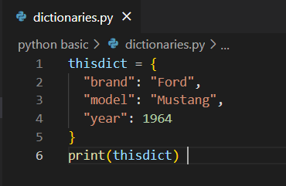

10. Dictionaries
Dictionary items are ordered, changeable, and does not allow duplicates.

Slide 20
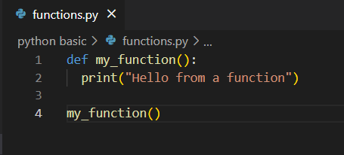

11. Functions
A function is a block of code which only runs when it is called.

Slide 21
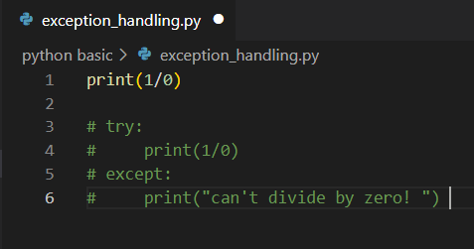
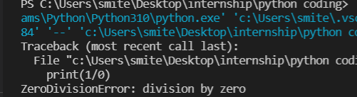
12. Exception handling
Without using exception handling:

Slide 22
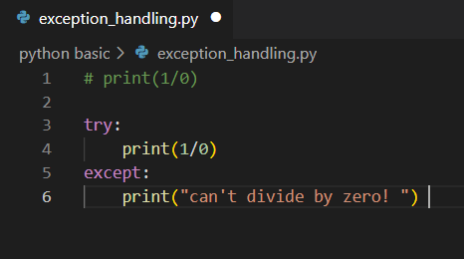

12. Exception handling
Using exception handling:

Slide 23
What I will learn in upcoming days...
Some advanced python concepts.
Regular expression in python.
Understanding and working with Django framework.

Slide 24
Thank You

